Slide 1


Dudley Orestil
25-04-2025

Slide 2

Outline
Executive Summary
Introduction
Methodology
Results
Conclusion
Appendix

Slide 3
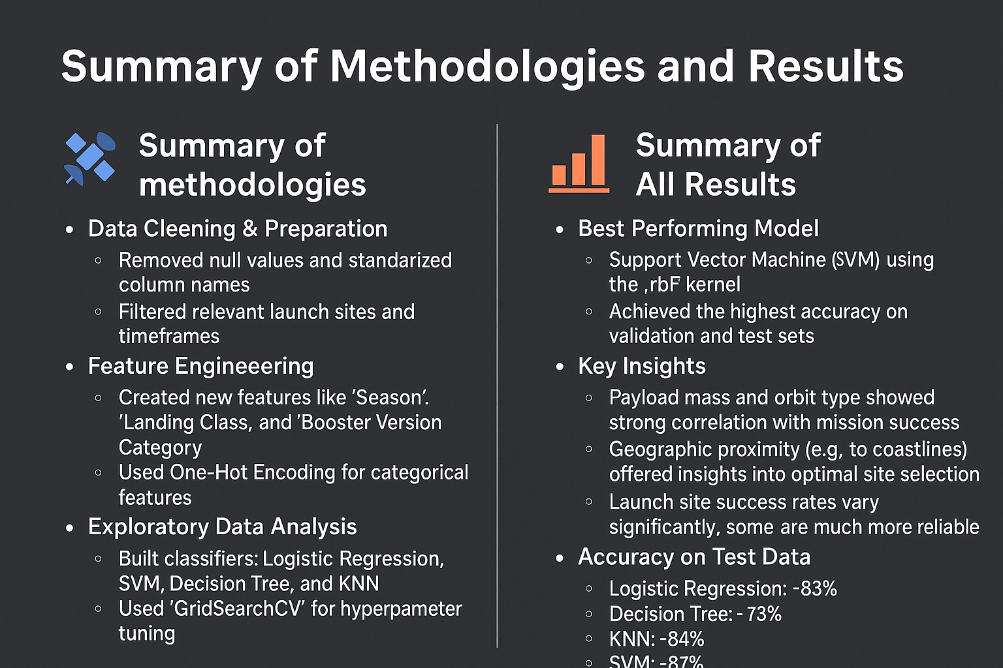
Executive Summary
Executive Summary

Slide 4
Introduction
1. Project background and context
1.1 Analyzing historical SpaceX launch data to gain insights into key factors affecting mission outcomes
1.2 Identifying the impact of various factors on the success of Falcon9 first stage landings
2. Problems we want to find answers
2.1 What are the critical factors that influence the success of falcon9 first-stage landings?
2.2 How can classification methods help in predicting successful outcomes?
2.3 Which classification algorithm is the most effective for this task

Slide 5

Section 1

Slide 6
Methodology
Executive Summary
Data collection methodology
Perform data wrangling
Perform exploratory data analysis (EDA) using visualization and SQL
Perform interactive visual analytics using Folium and Plotly Dash
Perform predictive analysis using classification models

Slide 7

Data Collection
The data was collected from publicly available datasets provided by SpaceX and IBM via cloud-hosted CSV files. These datasets included launch records, rocket specifications, payload detail, and outcome classifications.

Slide 8
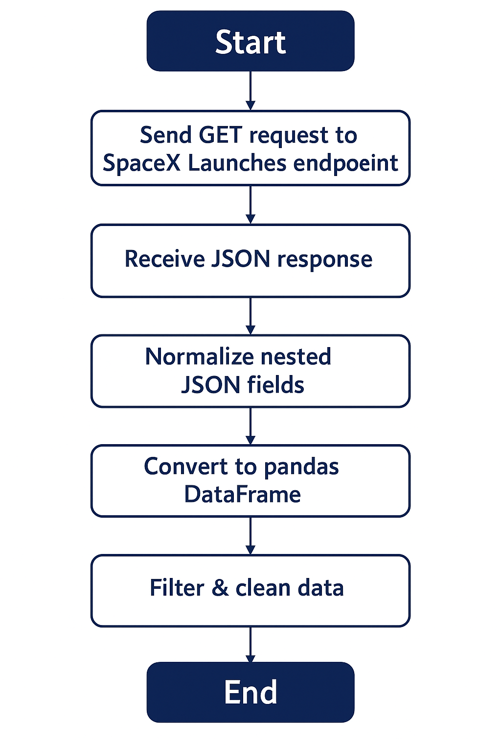
Data Collection – SpaceX API
We used the SpaceX REST API to retrieve launch data. A GET request was sent to endpoints like / launches. The JSON response was parsed and loaded into a DataFrame. We extracted relevant fields such as payload and outcome. The data then cleaned and prepared for analysis.
https://github.com/dee276/AppliedDataScience/blob/main/jupyter-labs-spacex-data-collection-api.ipynb

Slide 9
Data Collection - Scraping
The data was collected using web scraping techniques from public sources such as government websites and open datasets. Alibrary requests or js,fetch was used to access CSV files hosted online. The file were read and loaded into pandas DataFrames for further processing.
https://github.com/dee276/AppliedDataScience/blob/main/jupyter-labs-webscraping.ipynb
Start
Specify data source(url)
Send HTTP Request(fetch, request or js.fetch)
Receive response(csv, json, or html)
Parse and Extract data(pandas.read_csv or HTML parser)
Load into DataFrame(pd.DataFrame)
Clean & Validate Data(Check for NaN format type)
Store Data
End

Slide 10
Data Wrangling
Data Wrangling involves preparing raw data for analysis by cleaning and transforming it into a usable format. We began by inspecting the dataset and identifying missing or inconsistent values. Missing values were handled using deletion or imputation techniques. Categorical variables were encoded, and numerical features were scaled for model compatibility. These steps ensured the dataset was clean, consistent, and ready for modeling and visualization.
https://github.com/dee276/AppliedDataScience/blob/main/labs-jupyter-spacex-Data%20wrangling.ipynb
Start
Load Raw Data
Inspect Data
Handle missing value
Convert Data Types
Rename, Filter & Select Columns
Create new Features & Encode Categorical Variable

Slide 11
EDA with Data Visualization
Here’s a list of the chart we used for the exploratory data analysis phase and their purpose in each case.
https://github.com/dee276/AppliedDataScience/blob/main/edadataviz.ipynb
Bar chart : We use it to show the success rate by orbit type.
Scatter Plot : Visualized Flight Number vs. Launch Site by class; Showed correlation between payload mass and success rate across orbit types.
Line Chart : Tracked the success rate evolution over time.
Pie Chart : Showed success vs. failure distribution or total launches by site.

Slide 12
EDA with SQL
We used SQL to investigate the dataset inside the database. We can see on the right a list of the different queries we used.
https://github.com/dee276/AppliedDataScience/blob/main/jupyter-labs-eda-sql-coursera_sqllite.ipynb
cur.execute("select distinct Launch_Site from SPACEXTABLE")
cur.execute("select * from SPACEXTABLE where Launch_Site like 'CCA%' limit 5")
cur.execute("select SUM(PAYLOAD_MASS__KG_) from SPACEXTABLE")
cur.execute("select AVG(PAYLOAD_MASS__KG_) from SPACEXTABLE")
cur.execute("select MIN(DATE) from SPACEXTABLE where Landing_Outcome like 'Success’”)
cur.execute("select Booster_Version from SPACEXTABLE where Mission_Outcome like 'Success%' and PAYLOAD_MASS__KG_<6000 and PAYLOAD_MASS__KG_>4000 ")
cur.execute("select count(Mission_Outcome) from SPACEXTABLE where Mission_Outcome like 'Success' or Mission_Outcome like 'Failure’”)
cur.execute("select Booster_Version from SPACEXTABLE where PAYLOAD_MASS__KG_ = ( select MAX(PAYLOAD_MASS__KG_) from SPACEXTABLE)")
cur.execute("select substr(Date, 6,2) as month,Booster_Version,Landing_Outcome, Launch_Site from SPACEXTABLE where Landing_Outcome like 'Failure%' and substr(Date,0,5)='2015'")

Slide 13

Build an Interactive Map with Folium
First, we added a folium.map() that served to create the base map centered around NASA Johnson Space Center with a specific zoom level
Second, a folium.circle() to highlight launch sites with a colored radius.
Then a folium.marker() to add labels to launch sites with DivIcon (HTML text markers).
Followed by a folium.MarkerCluster() to group all individual launch attempts (many with the same coordinates) into clusters to reduce clutter.
We continued with a folium.PolyLine() which was drawn to connect launch sites to proximity locations (e.g., coastline, cities, railways).
Finally, a MousePosition plugin to enable real-time coordinate readout when moving the mouse across the map.
https://github.com/dee276/AppliedDataScience/blob/main/lab_jupyter_launch_site_location.ipynb

Slide 14

Build a Dashboard with Plotly Dash
Plots/Graphs Added :
Pie Chart – Launch Success DistributionDisplays the proportion of successful launches for all sites or a selected site. Helps visualize which site had the most successes or compare success/failure rates for a specific site.
Scatter Plot – Payload vs. SuccessShows the relationship between payload mass and launch success, color-coded by booster version.Helps analyze whether payload size impacts success and how different boosters perform.
https://github.com/dee276/AppliedDataScience/blob/main/spacex-dash-app.py
Interactive Elements Added
Dropdown Menu (Launch Site Selector)Allows the user to choose between "All Sites" or a specific launch site. Dynamically updates both the pie chart and scatter plot based on selection.
Range Slider (Payload Mass Filter)Lets users adjust the range of payload masses shown on the scatter plot. Useful to explore how performance varies by weight, and to filter out extreme or irrelevant values.

Slide 15
Predictive Analysis (Classification)
To build a reliable classification model for predicting SpaceX Falcon 9 landing outcomes, we tested four machine learning algorithms: Logistic Regression, Support Vector Machines (SVM), Decision Trees, and K-Nearest Neighbors (KNN).
https://github.com/dee276/AppliedDataScience/blob/main/SpaceX_Machine%20Learning%20Prediction_Part_5.ipynb
Model Building
Hyperarameter Tuning
Model Evaluation
Best Performing Model

Slide 16

Results
Exploratory data analysis results
Interactive analytics demo in screenshots
Predictive analysis results

Slide 17

Section 2

Slide 18
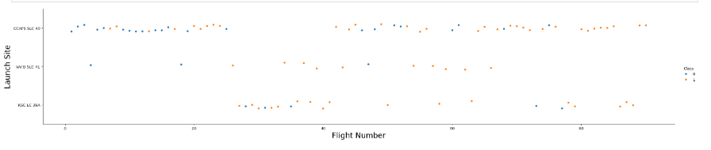
Flight Number vs. Launch Site
This scatter plot shows the outcome of SpaceX launches across different launch sites over time. Each point represents a flight, colored by outcome: blue for success, orange for failure. As flight numbers increase, the success rate improves, especially at major sites like KSC LC 39A and CCAFS SLC 40. This trend highlights both SpaceX's growing reliability and the performance differences between launch locations.

Slide 19
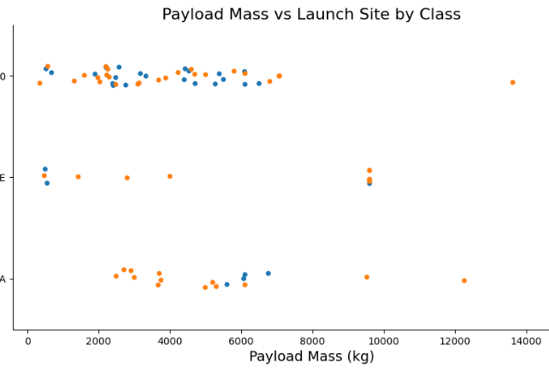
Payload vs. Launch Site
This plot illustrates the relationship between payload mass and launch success across three major SpaceX launch sites. Each dot represents a launch, with colors indicating success (orange = success, blue = failure). Most launches, especially from CCAFS SLC 40 and KSC LC 39A, cluster around 2,000–6,000 kg and show high success rates. Interestingly, even very heavy payloads (near 16,000 kg) show successful outcomes, highlighting SpaceX’s reliability regardless of payload size. VAFB SLC 4E has fewer data points but shows mixed results.

Slide 20
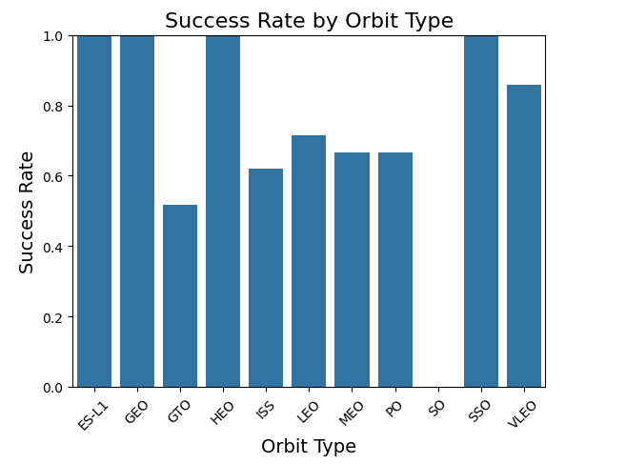
Success Rate vs. Orbit Type
This bar chart highlights the variation in launch success rates across different orbit types. Orbit types like ES-L1, GEO, HEO, and SSO show a 100% success rate, indicating a strong track record for these missions.

Slide 21
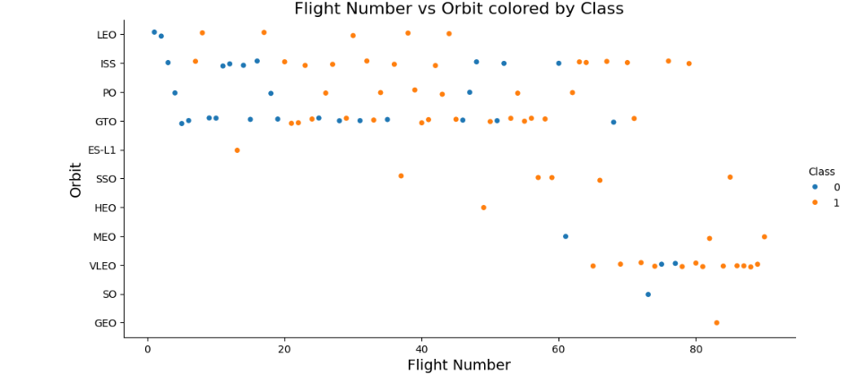
Flight Number vs. Orbit Type
This scatter plot illustrates the relationship between flight number and orbit type, with points colored based on the success class (orange for success 1, blue for failure 0). Each point represents a mission, and the vertical position indicates the target orbit. The plot reveals that:

Slide 22
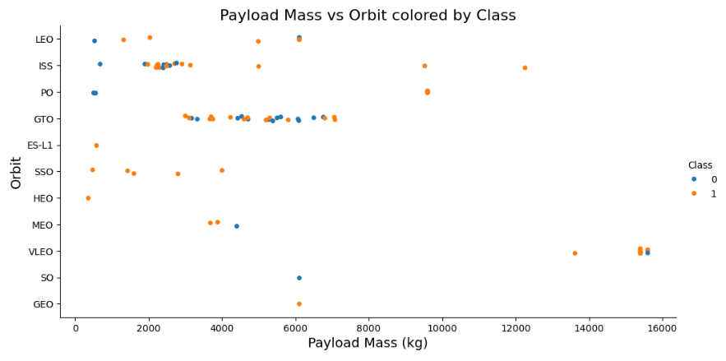
Payload vs. Orbit Type
GTO and LEO orbits show a wide range of payload masses, especially between 2000–6000 kg, and have a balanced mix of success and failure outcomes.
Higher payload missions (above 10,000 kg), especially in VLEO and SSO, tend to have more successful outcomes (more orange).

Slide 23
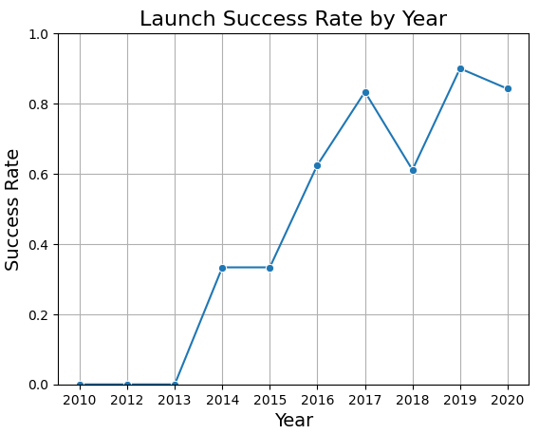
Launch Success Yearly Trend
2010 to 2013 show a 0% success rate, reflecting the challenges of early launch attempts or very limited data.
A noticeable improvement starts in 2014, with success rates steadily increasing.
2016 to 2019 demonstrate significant gains in reliability, peaking at over 90% success in 2019.
A slight dip appears in 2018 and again in 2020, but the overall trend reflects strong year-over-year improvements.

Slide 24
All Launch Site Names
select distinct Launch_Site from SPACEXTABLE
This SQL query retrieves a unique list of launch sites from the SPACEXTABLE.It removes duplicates and returns only one occurrence of each Launch_Site value that appears in the table.This is useful to quickly identify all different launch locations SpaceX has used.
The names of the unique launch sites
('CCAFS LC-40',)
('VAFB SLC-4E',)
('KSC LC-39A',)
('CCAFS SLC-40',)

Slide 25
Launch Site Names Begin with 'CCA'
select * from SPACEXTABLE where Launch_Site like 'CCA%' limit 5
SELECT *: selects all columns.
FROM SPACEXTABLE: from the table named SPACEXTABLE.
WHERE Launch_Site LIKE 'CCA%': filters the rows where the Launch_Site value begins with 'CCA'. The % acts as a wildcard for any characters after 'CCA’.
LIMIT 5: returns only the first 5 matching rows.
5 records where launch sites begin with `CCA`
('2010-06-04', '18:45:00', 'F9 v1.0 B0003', 'CCAFS LC-40', 'Dragon Spacecraft Qualification Unit', 0, 'LEO', 'SpaceX', 'Success', 'Failure (parachute)')
('2010-12-08', '15:43:00', 'F9 v1.0 B0004', 'CCAFS LC-40', 'Dragon demo flight C1, two CubeSats, barrel of Brouere cheese', 0, 'LEO (ISS)', 'NASA (COTS) NRO', 'Success', 'Failure (parachute)')
('2012-05-22', '7:44:00', 'F9 v1.0 B0005', 'CCAFS LC-40', 'Dragon demo flight C2', 525, 'LEO (ISS)', 'NASA (COTS)', 'Success', 'No attempt')
('2012-10-08', '0:35:00', 'F9 v1.0 B0006', 'CCAFS LC-40', 'SpaceX CRS-1', 500, 'LEO (ISS)', 'NASA (CRS)', 'Success', 'No attempt')
('2013-03-01', '15:10:00', 'F9 v1.0 B0007', 'CCAFS LC-40', 'SpaceX CRS-2', 677, 'LEO (ISS)', 'NASA (CRS)', 'Success', 'No attempt')

Slide 26
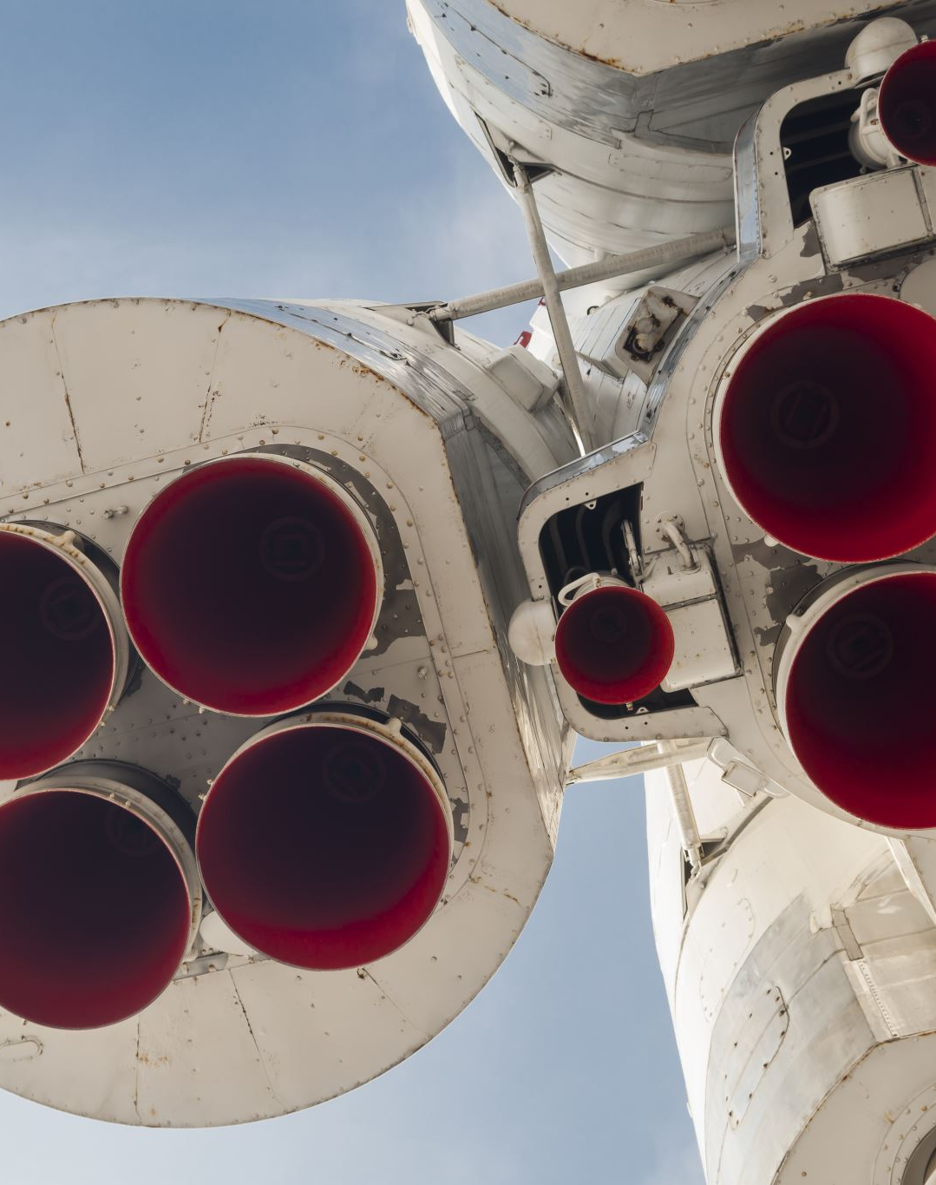
Total Payload Mass
select SUM(PAYLOAD_MASS__KG_) from SPACEXTABLE
This query returns the total payload mass (in kilograms) of all recorded SpaceX launches in the table. It's useful for understanding the cumulative mass launched by SpaceX. Which is 619 967 kg.

Slide 27
Average Payload Mass by F9 v1.1
select AVG(PAYLOAD_MASS__KG_) from SPACEXTABLE
This query returns the average payload mass carried by SpaceX launches in the dataset. It's helpful for understanding the typical payload weight across all missions. Which is 6138.28 kg

Slide 28
select MIN(DATE) from SPACEXTABLE where Landing_Outcome like 'Success’
SELECT MIN(DATE): Retrieves the earliest (minimum) date.
FROM SPACEXTABLE: From the table containing SpaceX launch data.WHERE Landing_Outcome
LIKE 'Success%': Filters only the rows where the landing outcome starts with the word "Success", such as "Success (ground pad)" or "Success (drone ship)".
This query finds the date of the first successful landing recorded in the dataset which is 2018-07-22
First Successful Ground Landing Date

Slide 29
Successful Drone Ship Landing with Payload between 4000 and 6000
To keep it concise, I will only display the first 5, for the full result you can look at the notebook through the link that was share in the previous section.:
( F9 v1.1',)
('F9 v1.1 B1011',)
('F9 v1.1 B1014',)
('F9 v1.1 B1016',)
('F9 FT B1020’,)
SELECT Booster_Version FROM SPACEXTABLE WHERE Mission_Outcome LIKE 'Success%' AND PAYLOAD_MASS__KG_ < 6000 AND PAYLOAD_MASS__KG_ > 4000;
This SQL query retrieves the booster versions from the `SPACEXTABLE` where the mission was successful, and the payload mass was between 4000 kg and 6000 kg. It uses a `LIKE 'Success%'` pattern to match any mission outcomes that start with "Success". The result filters for missions with moderate payloads and returns the corresponding booster versions.

Slide 30
Total Number of Successful and Failure Mission Outcomes
"select count(Mission_Outcome) from SPACEXTABLE where Mission_Outcome like 'Success' or Mission_Outcome like 'Failure’”
This SQL query counts the number of missions in the `SPACEXTABLE` where the `Mission Outcome` is either exactly "Success" or "Failure". It filters out other possible outcomes (e.g., partial failures, success with conditions). The result is a single number representing the total count of clear mission results. Which is 98

Slide 31
Boosters Carried Maximum Payload
To keep this document concise, I chose to show a partial list. We can see the full result by accessing the notebook from the GitHub link that was left in the previous section
F9 B5 B1048.4',) ('F9 B5 B1049.4',)('F9 B5 B1051.3',)('F9 B5 B1056.4',)('F9 B5 B1048.5',)('F9 B5 B1051.4',)('F9 B5 B1049.5',
select Booster_Version from SPACEXTABLE where PAYLOAD_MASS__KG_ = ( select MAX(PAYLOAD_MASS__KG_) from SPACEXTABLE)
That query select the Booster Version that have a payload mass equal to maximum value.

Slide 32
List of failed landing_outcomes in drone ship, their booster versions, and launch site names for in year 2015
('01', 'F9 v1.1 B1012', 'Failure (drone ship)', 'CCAFS LC-40')
('04', 'F9 v1.1 B1015', 'Failure (drone ship)', 'CCAFS LC-40')
"select substr(Date, 6,2) as month,Booster_Version,Landing_Outcome, Launch_Site from SPACEXTABLE where Landing_Outcome like 'Failure%' and substr(Date,0,5)='2015’”
This query retrieve the column of interest based on attribute like failure and year equals to 2015
2015 Launch Records

Slide 33
Rank Landing Outcomes Between 2010-06-04 and 2017-03-20
Landing outcomes (such as Failure (drone ship) or Success (ground pad)) between the date 2010-06-04 and 2017-03-20, in descending order
('No attempt', 10)
('Success (drone ship)', 5)
('Failure (drone ship)', 5)
('Success (ground pad)', 3)
('Controlled (ocean)', 3)
('Uncontrolled (ocean)', 2)
('Failure (parachute)', 2)
('Precluded (drone ship)', 1)
The following querie select the column of interest according to the dates then groups them by landing outcome and orders them in descending order by outcome count
SELECT Landing_Outcome, COUNT(*) AS Outcome_Count FROM SPACEXTABLE WHERE Date BETWEEN '2010-06-04' AND '2017-03-20’ GROUP BY Landing_Outcome ORDER BY Outcome_Count DESC

Slide 34

Section 3

Slide 35
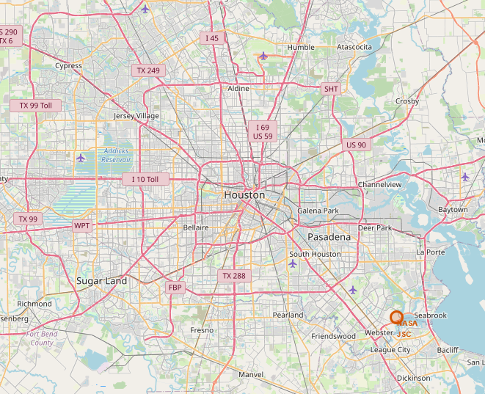
Map of the launch sites
Key elements to take away:
Most launch site are near the cost lines
Launch success tends to cluster around certain sites
Proximity to infrastructure which might influence supply chain

Slide 36
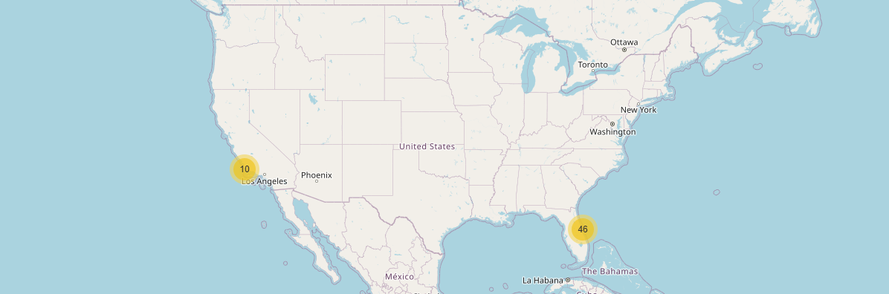
Insights from Color-Labeled Launch Outcomes
Key takeaway:
Limited failures at some site
Geographical pattern of failures
Effectiveness of Booster Recovery Strategies
Visual Performance comparison Across Sites

Slide 37
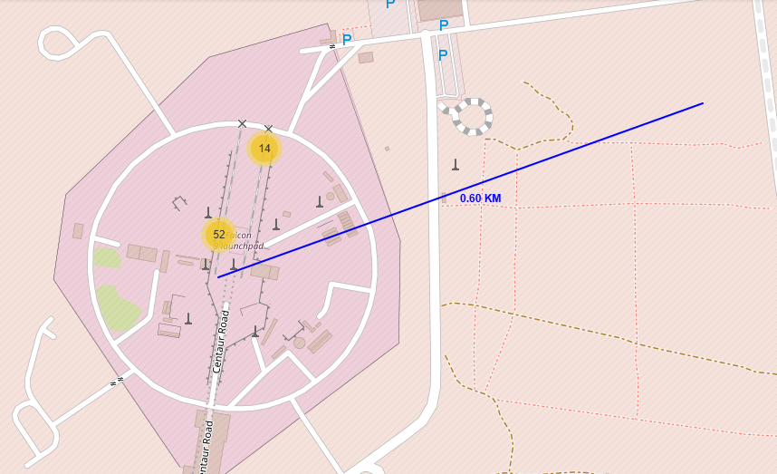
Relation between launch site and their proximities to infrastructure
Key takeaway:
This launch site is close to a railway. On the plus side this allows efficient transport of heavy equipment, rocket stage, and fuel.
Operational Flexibility: It ensures access to workforce and reduces maintenance cost.

Slide 38

Section 4

Slide 39
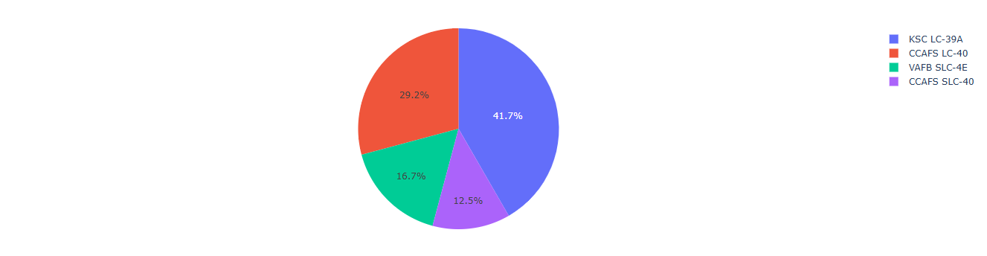
Launch success count for all cities
This pie chart displays the success rate of launches for all the different sites. We can tell that the most successful one is LC-39A which is represented by the blue portion of the chart.

Slide 40
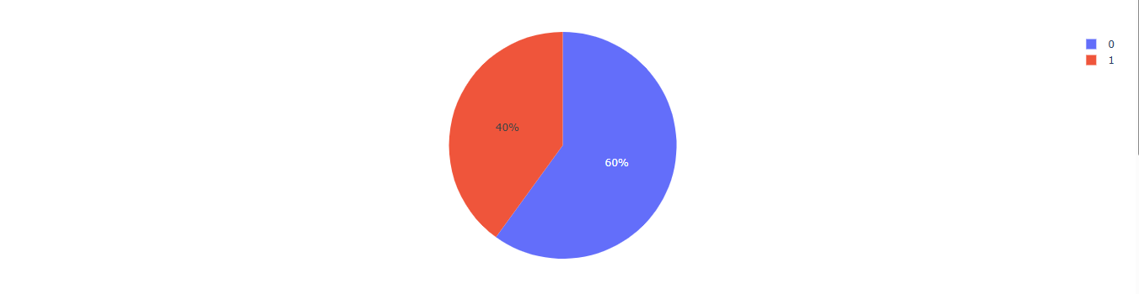
Launch site with highest success ratio
The site that showed the highest launch success ratio is SLC-4E which is shows by this pie chart.

Slide 41
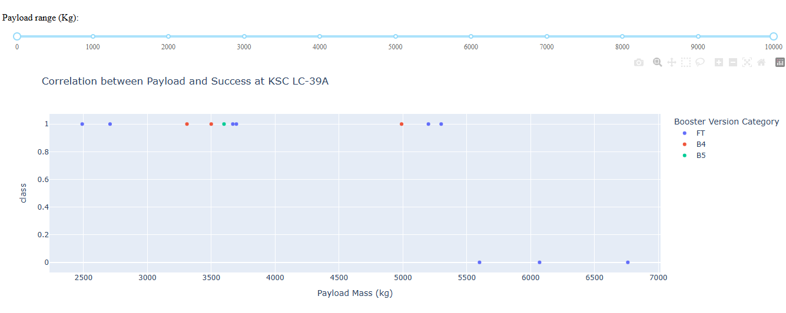
Payload vs Launch
This display the Payload vs Launch success for some range of payload. We can tell that the most success are between a payload of 2000 to 4000.

Slide 42

Section 5

Slide 43
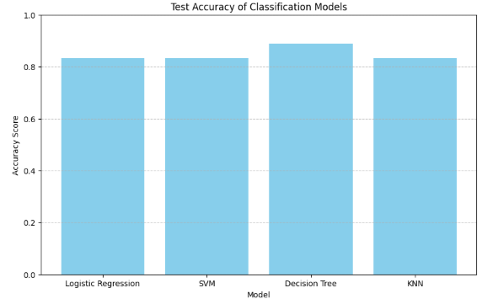
Classification Accuracy

Slide 44
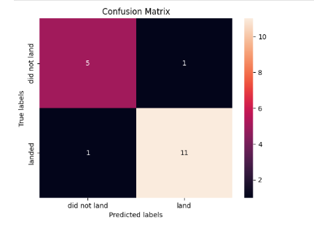
Confusion Matrix
The model is very accurate, with only 2 misclassifications out of 18 predictions.This balance between false positives and false negatives suggests the model is not heavily biased toward one class.Great indicator of reliability in predicting both successes and failures.

Slide 45
Conclusions
Launch Site Impact: CCAFS SLC 40 had the highest number of successful launches, while KSC LC 39A showed a consistently high success rate over time.
🚀 Payload Matters: Heavier payloads did not necessarily reduce success rates; successful landings were achieved across a broad range of payload masses.
🌐 Orbit Type Influence: Certain orbits like SSO and HEO showed 100% success rates, indicating they may be more favorable for mission success.
📈 Flight Progression: Later flights (higher flight numbers) were generally more successful, indicating technological and operational improvements over time.
📊 Modeling Accuracy: The Decision Tree classifier outperformed other models (Logistic Regression, SVM, KNN) with the highest test accuracy and a well-balanced confusion matrix
.🧠 Data-Driven Insights: Combining geospatial visualization, SQL queries, and classification models allowed us to uncover strong patterns and predict mission success with confidence.

Slide 46
Appendix
GitHub of all the necessary files to review the project:
https://github.com/dee276/AppliedDataScience/blob/main/SpaceX_Machine%20Learning%20Prediction_Part_5.ipynb
https://github.com/dee276/AppliedDataScience/blob/main/edadataviz.ipynb
https://github.com/dee276/AppliedDataScience/blob/main/jupyter-labs-eda-sql-coursera_sqllite.ipynb
https://github.com/dee276/AppliedDataScience/blob/main/jupyter-labs-spacex-data-collection-api.ipynb
https://github.com/dee276/AppliedDataScience/blob/main/jupyter-labs-webscraping.ipynb
https://github.com/dee276/AppliedDataScience/blob/main/lab_jupyter_launch_site_location.ipynb
https://github.com/dee276/AppliedDataScience/blob/main/labs-jupyter-spacex-Data%20wrangling.ipynb
https://github.com/dee276/AppliedDataScience/blob/main/spacex-dash-app.py

Slide 47


